Slide 1
LTS and Conformance v1 Roll Out
Objective of this plan is to provide the best experience for participating offerings to learn, implement and resubmit for conformance v1

Slide 2
Feb 21 - LTS Blog
Feb 25 - Zowe v1.10.0 GA
March 24 - Conformance v1 go-live
May 22nd Conformance v1 takes effect
Long Term Support Announced
Long Term Support Implemented
Changes to Conformance Announced
Conformance Changes Implemented
60-day recertification period
Community Events
vNext Conformance Enforcement
1Q
2Q
Action Items
All conformance DRAFT criteria must be updated by the squad owners in confluence - 2/7/2020
New Draft of Conformance criteria migrated and reformatted on git hub (solicit help from doc squad on formatting) - 2/14/20
Publish and promote the LTS Blog/Next Issue of the Zoweian (link to draft conform. criteria) - 2/21/2020
LF to notify all conformance participants of pending conformance changes – 2/28/2020
Complete socialization of criteria with key stakeholders - 3/4/2020
LF to review/approve new criteria - 3/6/2020
LF to update community links with new Test Evaluation Criteria - 3/24/2020
LF to update all conformance logos and versioning - 3/24/2020
LF/Community to expect influx of new/re-conformance applications
LF to follow-up with conformance participants about re-certifying

Slide 3
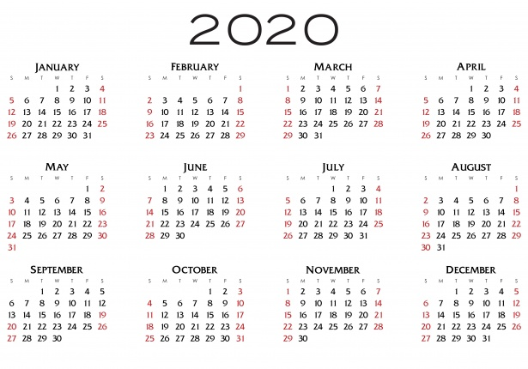
LTS Conformance Timeline
February
Fri 2/7
Conformance Test Evaluation changes submitted by all squads: API-ML, App Framework, CLI
Confluence Location: https://wiki.zowe.org/display/ZCP/Test+Evaluation+Guide
Zowe ZLC Review / Approve
Tue 2/14
Conformance Test Evaluations migrated to Github
Doc Squad to assist in formatting
Send plan to OMP Marketing List
Fri 2/21
OMP Notifies conformant participants of pending changes
Publish/Promote (include links to V1 Conformance Test Evaluation forms)
LTS Blog
Zowian

Slide 4
LTS Conformance Timeline
February / March
Tue 2/25
Zowe 1.9 LTS GA Announcement: https://github.com/zowe/community/blob/master/Project%20Management/Meeting%20Minutes%20and%20Agenda/20200116/Meeting%20Minutes.md
Fri 2/28
Conformance Test Evaluation Form changes socialized with key stakeholders
OMP sends email notification requesting feedback by 3/4
Github location: TBD
Fri 3/6
OMP completes final review/approval of Test Evaluation Form Changes

Slide 5
LTS Conformance Timeline
March - May
Tue 3/24
Conformance Test Evaluation V1 GO LIVE
Github location: TBD
OMP Updates Conformance Links
OMP Updates Conformance “marks” [logos and versioning]
OMP prepared for influx of conformance evaluation forms
Tue 3/24 - Thu 5/21
OMP processes conformance evaluation forms
Fri 5/22
V1 Conformance GO LIVE
Any existing “conformers” will lose their badge? or not earn the V1 badge if forms have not been submitted by this time

